Slide 1
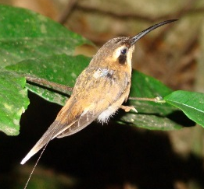
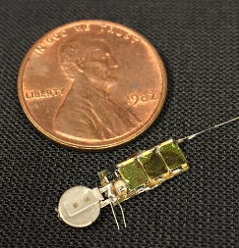
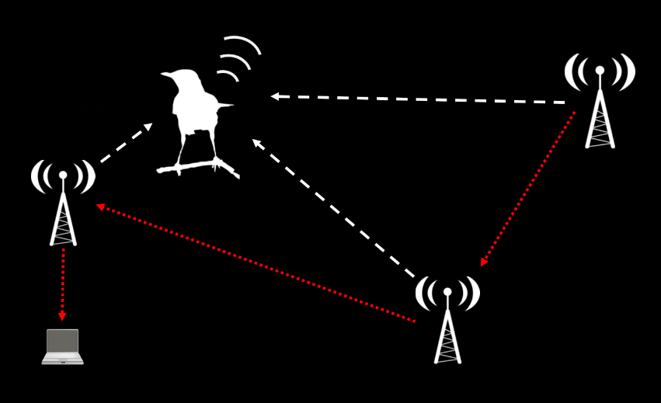
AMRUPT (Animal Movement Research Using Phase-based Trilateration)

Slide 2
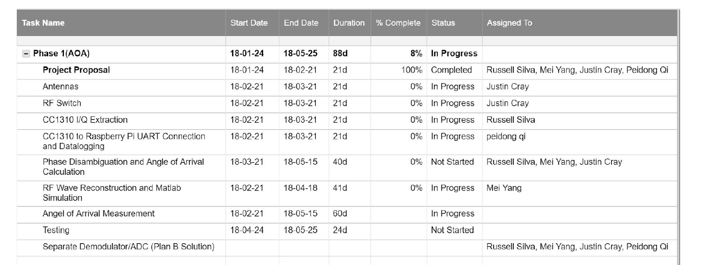
Management plan

Slide 3
Management plan

Slide 4
Justin Cray, spring 2018 initial goals
Antenna design:
Determine best type of antenna to use (whip, dipole, COTS PCB)
Isotropic
Sensitive
Physically robust and high tolerance in manufacturing specs
Minimally impacted by being close to other antennas in an array
Low cost
Able to receive all potential frequencies to be used (150 MHz - ~300 MHz)
PCB design (antenna footprints, LNA, trace specifications, ground plane)
Testing
RF switch:
Evaluate pros/cons of RF switches
Isolation
Insertion loss
Switching speed
Slew rate
Cost
PCB design (RF switch footprint requirements [e.g. isolation to avoid parasitic effects])
Testing
Work with Mei to model required specs for a given level of precision of AOA
Consult with Dr. Kan

Slide 5
Russell Silva, spring 2018 initial goals
Phase extraction from CC1310:
Determine how to extract I/Q data from CC1310
Plan A: Make contacts with TI to identify correct way to update I/Q data register
Plan B: Work with others in the AMRUPT group to troubleshoot code
Work with Peidong to determine format of resulting data (is it a binary text file?)
Work with Mei to do RF simulations to determine required sample rate
Can the interrupt be triggered, and buffer be updated and emptied quickly enough? (Highest Nyquist frequency is ~600 MHz!)
PCB design (CC1310 footprint, power supply, trace specifications)
Testing
Consult with Dr. Kan

Slide 6
Peidong Qi, spring 2018 initial goals
Transfer of phase data from CC1310 to Raspberry Pi:
Work with Mei and Russell to do RF simulations to determine required sample rate (stay above Nyquist frequency) and bit depth (minimize quantization error)
Determine how to transfer data from CC1310 to the Pi
Plan A: UART, if simulations suggests UART speed is sufficient
Plan B: SPI, otherwise
Work with Russell to determine the format of resulting data (is it a binary text file?)
Write program to decode, format, process, and save resulting phase information
PCB design (Raspberry Pi shield design, power supply, trace specifications)
Testing
Consult with Dr. Kan

Slide 7
Mei Yang, spring 2018 initial goals
RF wave reconstruction and simulations:
Work with Peidong and Russell to do RF simulations to determine required sample rate (stay above Nyquist frequency) and bit depth (minimize quantization error)
Work with Justin to define required RF switching characteristics
Learn Dr. Kan’s simulation model and adapt it for our system architecture
Consult with Dr. Kan

